Slide 1
REPORTLAB COMPLETE TUTORIAL
Create Custom Report Template:Part 59
TOTAL TECHNOLOGY

Slide 2

Template
TOTAL TECHNOLOGY

Slide 3
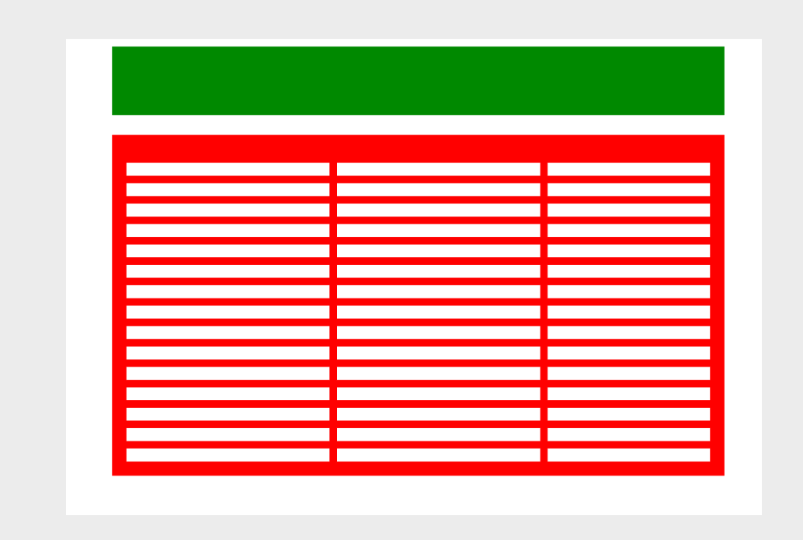
Template
TOTAL TECHNOLOGY

